Slide 1



One Europe, One Market.
An Energy Traders Europe roadmap to
complete the Single Market for Energy
by 2028.
Notes:
2. Policy Update

Slide 2


A common crisis demands common solutions
At European level
Mitigating long-term impacts
Doing the basics well
  Reducing long-term dependence
  Don’t question the fundamentals
  Avoid hasty, national policies
  Strengthen, rather than weaken, the gas market
  Learning the lessons from 2022
  Ensuring that gas can easily reach Europe
  Using targeted, short-term measures
  Strong implementation & enforcement
  Appropriate assessment of measures
  Clear State Aid frameworks
energy traders europe | Integrate by '28
Notes:
2. Policy Update
For consumers:
Lower and more stable energy prices through stronger cross-border competition and better use of Europe’s grids
Higher energy security, reducing the risk of shortages, curtailment, or supply interruptions
More predictable long-term price signals, improving investment decisions for energy-intensive industries
Lower balancing and hedging costs thanks to deeper liquidity

Slide 3
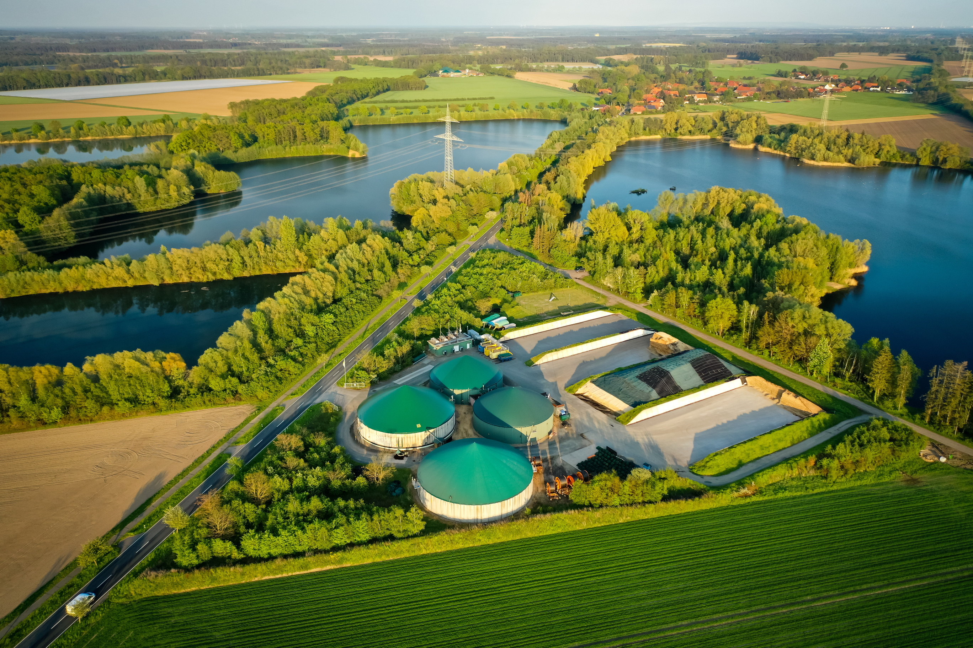
We must strengthen Europe’s energy market
1. Use the infrastructure better
2. Make the rules simpler
3. Be competitive globally
4. Attract investment
5. Have a vision, stick to the plan
  The European market has lost momentum
  Consumers need us to find it again
  Too many national differences
  Burdensome reporting and excessive licensing
  Integration is simplification
  We’re not as attractive as we could be
  We have to make cargoes want to come to the EU
  There is a chance to attract funds
  And our net zero goals depend on it
  Act together
  Grids and pipelines are not used efficiently
  Cross-border bottlenecks limit cheaper flows
This Forum needs to put us on the path to deeper integration & less dependence.
energy traders europe | Integrate by '28
Notes:
2. Policy Update

Slide 4
EU needs to act together in face of energy crises
Support for energy security and affordability should focus on improved markets integration.
Our response to the current supply shock looks like we might fail to learn the lessons of the 2022 crisis:
  We're not acting together;
  Some are questioning the basics of energy and carbon markets and making uncertainty worse;
  We risk making it harder to bring gas to Europe (and some policies even increase gas demand);
  We don't have a clear sense of which customers to help; and
  For a long-time we've not prioritised the basics – like implementation and enforcement of the EU Acquis.
  The consequence is less security and more cost.
  2) The path we need to be on is clear – further integrate markets, speed up decarbonisation and tackle common challenges together. We talk about a European market a lot. This forum needs to ask itself whether we value having one? And if we do – we need to start acting like we value having one and make sure we leave with a meaningful commitment to create one.
energy traders europe | Integrate by '28
Notes:
3. Market Update
Ad-hoc, non-transparent interference with storage filling is harmful and increases costs significantly, while also decreasing the incentive for market participants to fill storages commercially.
Any potential interference with wholesale gas prices, like price-caps, etc., reduces willingness to import gas the EU.
Measures that are not in line with the EU Acquis fragment the market and create dangerous precedents.
Unforeseeable changes to tariffs, notably when done mid-year, discourage booking in the longer term and inflate spreads between Member States

Slide 5
There is more we can do to make Europe attractive
We are creating avoidable uncertainty, which risks making a difficult situation worse
3.1.1 Issue clear guidance to make the authorisation processes for non-Russian gas as robust as possible
  We have created an unclear patchwork of rules applying to the Russian gas phase out. As a consequence, there are different import requirements in each MS.
  “The Forum urges the Commission to coordinate the development of a harmonised pre-authorisation procedure, allowing for mutual recognition of authorisations, in cooperation with the industry and the competent authorities.”
3.1.2 Amend the methane emissions regulation to access global LNG supplies
  MER makes it harder and more costly to get gas into Europe, as importers are not given the means to comply with the Regulation.
  Europe becomes less attractive, costs to customers rise as a consequence.
  “The Forum urges the Commission to start a revision of requirements under MER and suspend their application as a matter of priority.”
energy traders europe | Integrate by '28
Notes:
3. Market Update
Methane Emissions Regulation
Industry’s primary objective is to be compliant. Ensuring that operators are placed in the condition to comply requires clear, proportionate and achievable obligations and provisions. This is key to reducing the risk of systematic non‑compliance, contributing to better environmental outcomes without compromising Europe’s security of supply.
Guidances are a welcome support from the EC, but have no concrete impact in terms of legal certainty – something that can only be delivered by change in the EU legislations and its timeline and a fully harmonised implementation in all Member States
Key elements required for compliance are still missing, which makes compliance with EU MR provisions hard or impossible to achieve for economic operators. In the current context, the only valid guidance is to have a pan-European grace period associated with a proper grandfathering of the contracts signed in the interim period.
Fragmentation in national implementation, regarding the establishment of penalty regimes, the acceptability of compliance solutions, and the import requirements, exposes importers to significant risks, hindering the conclusion of new contracts.

Slide 6
Market integration can deliver more
Further strengthening our Internal Energy Market is one of the quickest and the most effective way of strengthening competitiveness
Through integrating markets rather than fragmenting them, and by relying on competition rather than intervention, Europe can turn its Internal Energy Market into a decisive strategic asset to
driving competitiveness,
enhancing security,
delivering climate goals, and
protecting consumers
“The Forum recognizes the good performance of the EU gas market in face of the recent supply shocks, both in terms of ensuring alternative sources of gas and redirecting the flows accordingly.”
energy traders europe | Integrate by '28
Notes:
3. Market Update

Slide 7
We praise the work carried out by the Energy Community Secretariat
Energy Community Secretariat initiatives supporting market development in the region bring tangible results and we gladly support them.
Ukraine’s continued work on improving its gas market is commendable.
Progress in developing a gas market in Moldova over the course of last year is impressive and worth emphasizing.
Barriers to enter the markets of the Energy Community remain high, amplified by additional licensing and reporting obligations, requiring local establishments etc. Works on simplifying and harmonising the rules as well as increasing transparency should be prioritised.
Compliance with the EU acquis remains the main priority – work-arounds like “Route special capacity products” should be removed.
Notes:
4. Market functioning in the Energy Community

Slide 8
Use the internal market to drive decarbonisation
A common Target Model should be the key priority to enable the uptake of biomethane in Europe
4.2.3 EU-wide support scheme for biomethane
  Design of national support schemes blocks cross-border trade, fragments the market
  By the end of 2026, through the revision of the Renewable Energy Directive (RED), Member States should be required to ensure that their national schemes and related targets do not constitute a barrier to cross-border trade
4.2.4 Align and simplify the biomethane certification schemes
  European rules on certifying the sustainability of biomethane are being implemented inconsistently across Member States
  We need to be in a position where the sustainability credentials of biomethane can be demonstrated on a standardised certificate which is recognised across the continent.
energy traders europe | Integrate by '28
Notes:
7. EU Energy Platform: Gas and Biomethane Mechanism

Slide 9
Use the internal market to drive decarbonisation
A common Target Model should be the key priority to enable the uptake of biomethane in Europe
“The Forum agrees that the current crisis demonstrates the importance of kick-starting Europe’s biomethane market, including ensuring tradability across borders. The Forum asks the Commission to establish a task force with the industry to coordinate the works on developing a uniform biomethane target model and report the results to the next forum.”
energy traders europe | Integrate by '28
Notes:
7. EU Energy Platform: Gas and Biomethane Mechanism
The gas market works well and market participants take decisions based on robust price signals. Repeated (especially non-transparent) interventions in market mechanisms, however, force them to adjust their expectations, which increases volatility and affects prices.
Harmonisation of compliance schemes: Almost all Member States have national schemes to support the uptake of biomethane and not a single one is identical to the another. Harmonising national compliance schemes would remove another driver of market fragmentation. Transition towards EU-wide support schemes for biomethane should be the ambition.
Harmonisation of certification among MS: While EU rules outline common terms set to govern trade in biomethane, evidencing sustainability is done differently in Member States, often in a discriminatory manner which precludes imports, exports or both;
A State Aid Framework that ensures a level playing field among market participants and cohesion of the internal market is also essential; overcompensation must be avoided.
A strong push for enforcing the already agreed rules is needed to realise the EU biomethane production ambition and enable the uptake of biomethane in the Union’s energy mix; this includes a fully operational UDB to be implemented by all MS.

Slide 10
Russian gas phase-out can only be ensured through closer cooperation
A common procedure for import authorisation is critical for ensuring security of supply
3.1.1 Issue clear guidance to make the authorisation processes for non-Russian gas as robust as possible
Country-specific, often very manual pre-authorisation procedures are being set up.
They differ in terms of scope, granularity and even deadlines.
In some cases, requirements go beyond the scope of the underlying regulation. Sometimes the information requested are not accessible to importers. This makes them counterproductive.
Reporting requirements end up being duplicated, doubling the bureaucratic burden that is already difficult to handle.
In a considerable number of MSs, the process has not been defined (DE, NL, PL, …) – and the deadline has passed. This already affects markets.
Notes:
8. REPowerEU

Slide 11
Russian gas phase-out can only be ensured through closer cooperation
A common procedure for import authorisation is critical for ensuring security of supply
This should:
Build on documents that can be obtained by importers
Be as simple as possible, allowing for swift verification and authorization
Ensure that legitimate gas can be delivered anywhere in the EU
Allow for granting authorisation for the entire duration of the contract
“The Forum urges the Commission to coordinate the development of a harmonised pre-authorisation procedure, allowing for mutual recognition of authorisations, in cooperation with the industry and the competent authorities.”
energy traders europe | Integrate by '28
Notes:
8. REPowerEU
LNG contracts often have optionalities. Importers are those who are securing the supplies, but they don’t always hold all information. Note that there is some lead time for nominations, authorisation cannot happen last minute. Certificate of origin is not necessarily a certificate of place of production - but at least this is passed through the chain.

Slide 12
Europe already has most of the legal, institutional and market foundations required
to create a truly integrated energy market.
Our success depends on execution, leadership and political will
Deviations from the EU acquis create a dangerous precedent and need to be addressed. Consistent implementation remains critical for the completion of the internal market.
The initial integration of the European energy market was grounded in a Target Model, developed collaboratively and delivered collectively by stakeholders. This process was underpinned by a clear sense of direction and a shared commitment to work over a long period to reach that goal. Perhaps it is time for Target Model 2.0
“The Forum encourages the Commission and ACER to actively protect the integrity of the market, intervene when rules are ignored and explain the benefits of integration. At the next Forum, discussions on how to intensify works on integration should be prioritised.”
energy traders europe | Integrate by '28
Notes:
9. Hydrogen and Decarbonised Gas Markets Package – Implementation
It is 12 years past the deadline for 3rd Gas Package implementation, we are still facing challenges and the implementation across MSs is not uniform/complete.
Tariff levels forecasting has become impossible and falling throughput only fuels the tariff spiral. The upcoming publication of the ACER efficiency benchmark is a good opportunity to intensify works on addressing this problem.

Slide 13
Europe already has most of the legal, institutional and market foundations required
to create a truly integrated energy market.
Our success depends on execution, leadership and political will
Implementation of the 4th Gas Package:
In view of the challenge of reviewing the Network Codes, better governance is needed to deliver recommendations in a timely manner.
Ex-post discounts to RES & low-carbon gases will not support the uptake of these gases while creating considerable challenges to implement. This will make the governance around tariff setting even more non-transparent.
Diverging quality requirements should not lead to market fragmentation as this goes against the spirit of the internal market and places security of supply at risk.
Similarly, quality issues should not delay or prevent decarbonisation through imposing standards that cannot be met by biomethane/hydrogen producers.
energy traders europe | Integrate by '28
Notes:
9. Hydrogen and Decarbonised Gas Markets Package – Implementation
It is 12 years past the deadline for 3rd Gas Package implementation, we are still facing challenges and the implementation across MSs is not uniform/complete.
Tariff levels forecasting has become impossible and falling throughput only fuels the tariff spiral. The upcoming publication of the ACER efficiency benchmark is a good opportunity to intensify works on addressing this problem.

Slide 14
Network Codes and Guidelines
CAM NC revision long overdue
2.1.3 Ensure the existing gas network is used efficiently
New flexibilities offered under the revised CAM NC enable cost saving and may support better network utilisation – works need to be finalised and early implementation should be encouraged.
In view of the upcoming expansion of the auctions number, robustness of the booking platforms needs to be ensured.
Notes:
10. Network Codes and Guidelines

Slide 15
Network Codes and Guidelines
The problem of ever-increasing tariffs needs to be urgently addressed;
Discussions on TAR NC need to start immediately
We observe that many Member States are changing tariff calculation methodology too frequently.
Tariff levels forecasting has become impossible and falling throughput only fuels the tariff spiral. The upcoming publication of the ACER efficiency benchmark is a good opportunity to intensify works on addressing this problem.
Additional threats may be stemming from cross-subsidisation between gas/electricity/hydrogen networks if clear rules are not in place. As a general principle, cross-subsidies need to be avoided.
2.1.7 Strengthen the Gas Tariff Network Code to enhance stability and facilitate trade
Notes:
10. Network Codes and Guidelines
As gas consumption continues to fall, discussions need to be held over the ways through which the tariff spiral problem should be addressed. Both short-term remedies and long-term solutions need to be considered.

Slide 16
Network Codes and Guidelines
INT NC Revision
Shippers and traders have no control over the quality of gas in the system, and should not be made liable for any issues arising.
Where TSOs have discretion over whether to accept marginally off-spec gas, the basis for refusal should be clear and TSOs should be encouraged to accept rather than refuse the gas wherever possible. Dual network companies (hydrogen and gas operators) should avoid conflicts of interests.
Notes:
10. Network Codes and Guidelines

